Slide 1
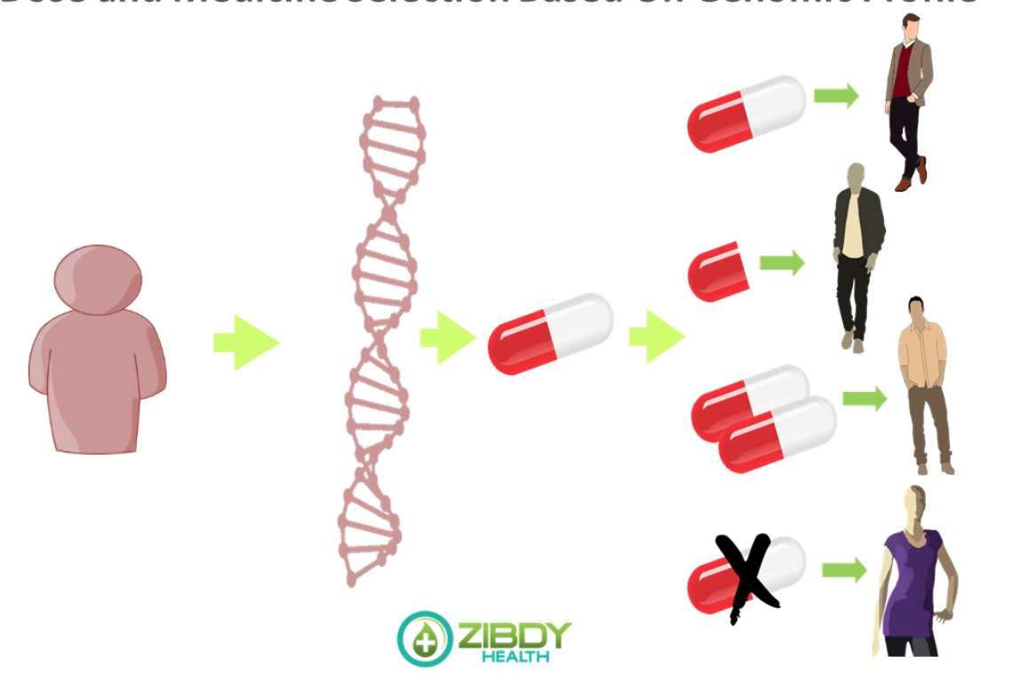
Application for the Data Science Fellowship, Anna Cieślak, May 5th 2021 Integration of machine learning and pharmacogenomic investigation for predicting response to treatment of idiopathic pulmonary fibrosis
Pharmacogenomics for personalized medicine
Idiopathic pulmonary fibrosis. National Heart, Lung, and Blood Institute

Slide 2
GOALS
Determine the most performing machine learning frameworks for prediction of drug response and survival followed by the assessment of their performance on multiple clinical cohorts of IPF patients
capture intricate biological interactions linked to specific drug response pathways
provide a proof of concept for the use of machine learning-based frameworks to aid precision antifibrotic treatment strategies.

Slide 3
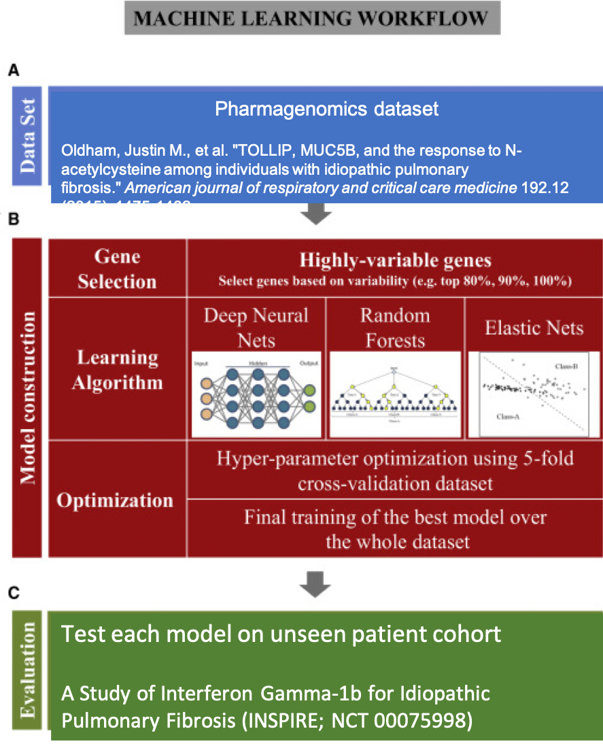

Slide 4
Expected Results
To demonstrate the genetic makeup of individuals with IPF may influence their response to antifibrotic therapy.
To provide a tool for delivery of personalized treatment with high efficacy, identifying molecular disease signatures and matching them with the most effective therapeutic interventions
highlight the importance of pharmacogenetics in IPF and support systematic biospecimen collection in IPF clinical trials so that genetic subgroups predisposed to treatment-related benefit or harm can be identified.

